Slide 1

Chapter 2:
Data Visualization
Notes:
‹#›

Slide 2
Objective
Understand the concept and importance of data visualization in the context of data mining.
Explore the goals and benefits of using data visualization techniques.
Learn various techniques for numerical data, including line charts, bar charts, scatter plots, etc.
Understand the techniques specific to non-numerical data, such as pie charts, word clouds, network graphs, etc.
Gain insights into the visualization of dashboards, including the components, design principles, and interactive features.
‹#›

Slide 3
Visualization of Dashboards
Dashboards
Dashboards are visual interfaces that provide a consolidated view of key information and metrics, allowing users to monitor and analyze data in real-time. They combine various visualizations, charts, tables, and other components to present an overview of relevant data and facilitate decision-making.
‹#›

Slide 4
Visualization of Dashboards
Definition and Purpose of Dashboards
Dashboards are interactive visual displays that present summarized and actionable information at a glance. They are designed to provide a comprehensive view of key performance indicators (KPIs), metrics, and trends for effective monitoring and decision-making.
The purpose of dashboards is to provide users with relevant and timely insights, enabling them to assess performance, identify issues or opportunities, and take appropriate actions.
‹#›

Slide 5
Visualization of Dashboards
Components of a Dashboard
Widgets: Dashboards consist of various widgets such as charts, graphs, tables, gauges, or maps, representing different aspects of the data.
Filters: Interactive filters allow users to customize the view of the dashboard by selecting specific dimensions, time periods, or other parameters.
Drill-down and Drill-up: Dashboards often provide the ability to drill down into specific details or drill up to higher-level summaries for deeper analysis.
Alerts and Notifications: Dashboards may include alerts or notifications that highlight critical information or anomalies, helping users stay informed about important events or changes.
‹#›

Slide 6
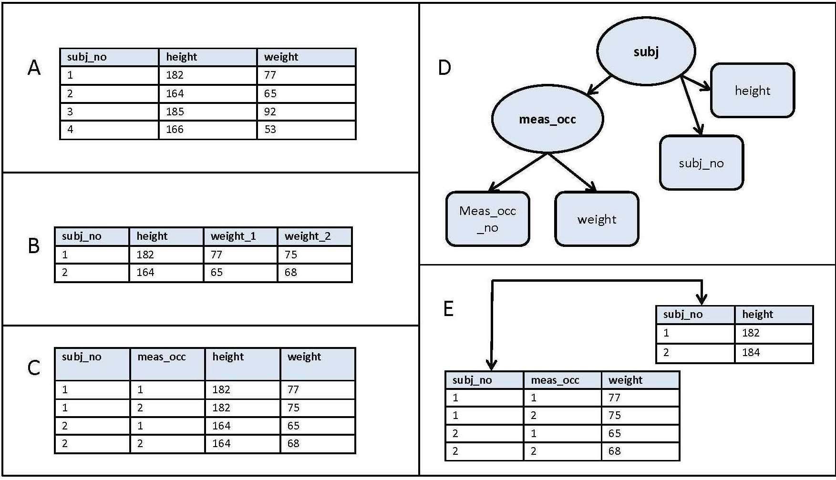
Visualization of Dashboards
Design Principles for Effective Dashboards
Data Organization and Layout: Arrange the components of the dashboard in a logical and intuitive manner, ensuring that related information is grouped together for easy understanding.
[Credit: https://www.datawiz.com/ ]
‹#›

Slide 7
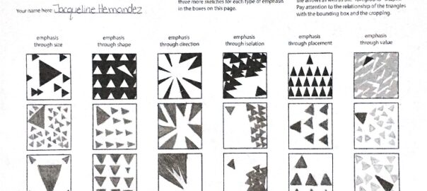
Visualization of Dashboards
Design Principles for Effective Dashboards
Visual Hierarchy and Emphasis: Use visual cues such as size, color, and positioning to emphasize important data and guide users' attention to the most relevant insights.
[Credit: https://www.datawiz.com/ ]
‹#›

Slide 8
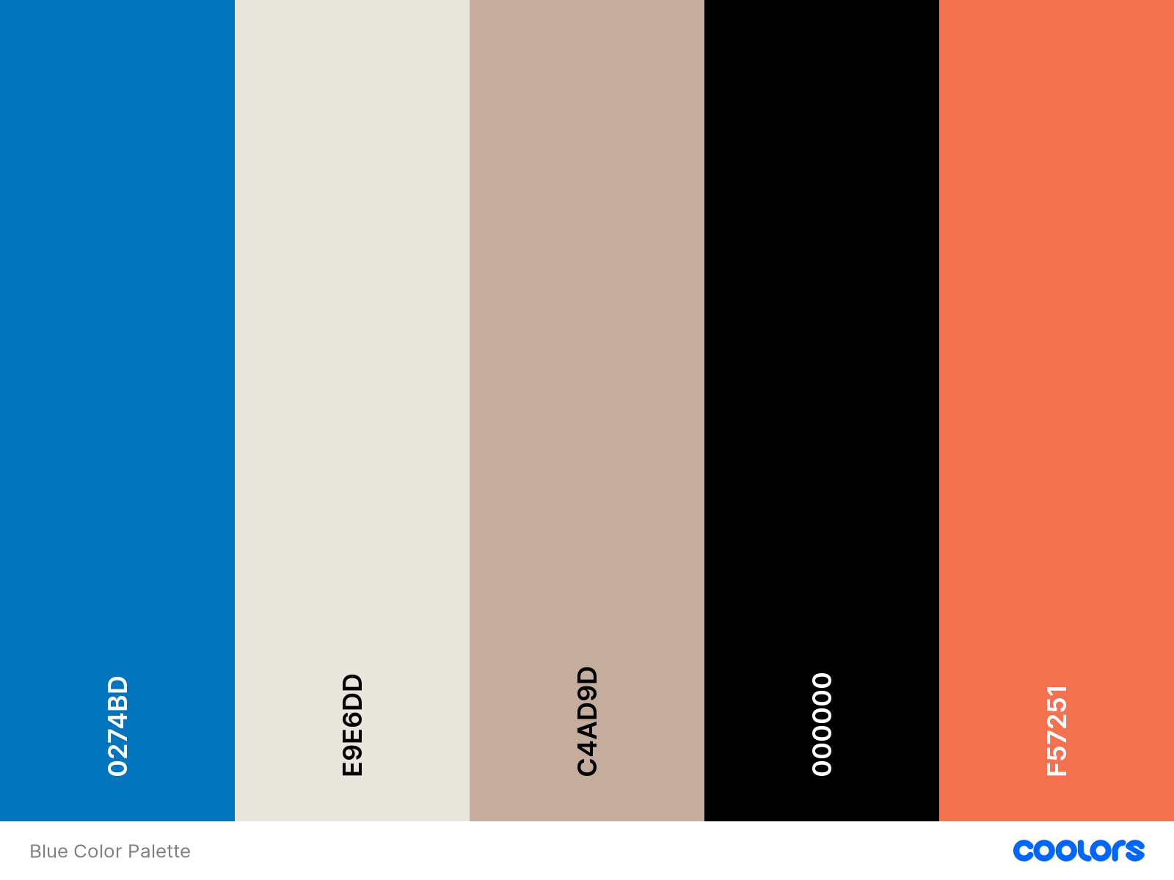
Visualization of Dashboards
Design Principles for Effective Dashboards
Color Schemes and Aesthetics: Choose a visually pleasing color scheme that aligns with the data and the overall purpose of the dashboard. Avoid overwhelming or distracting color combinations.
[Credit: https://www.datawiz.com/ ]
‹#›

Slide 9
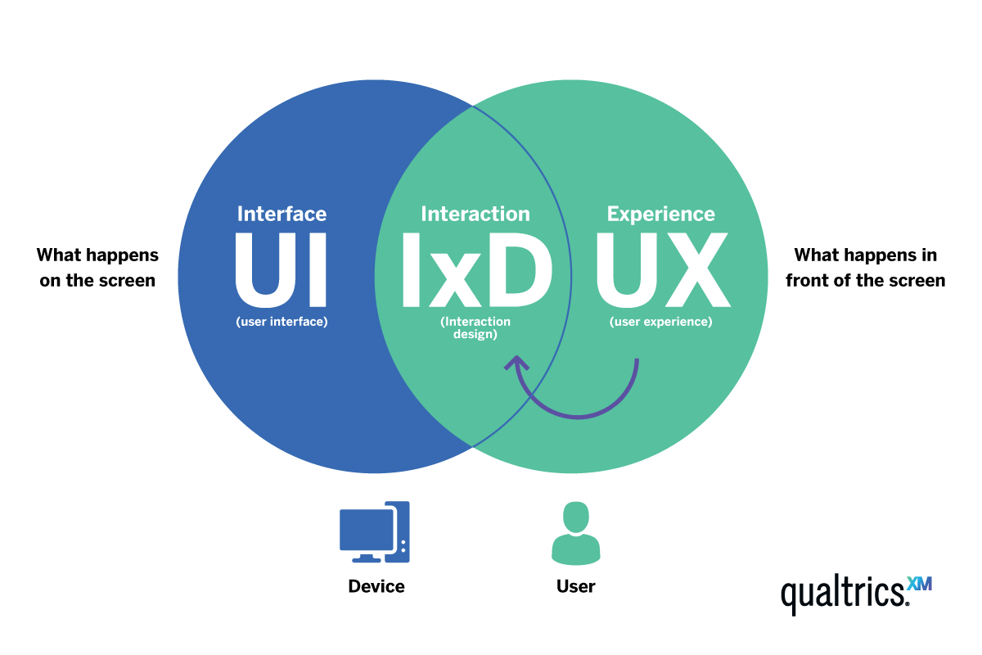
Visualization of Dashboards
Design Principles for Effective Dashboards
Interactivity and User Experience: Incorporate interactive features like hover effects, tooltips, and clickable elements to provide a smooth and engaging user experience. Allow users to interact with the dashboard and explore the data based on their specific needs.
[Credit: https://www.qualtrics.com/ ]
‹#›

Slide 10
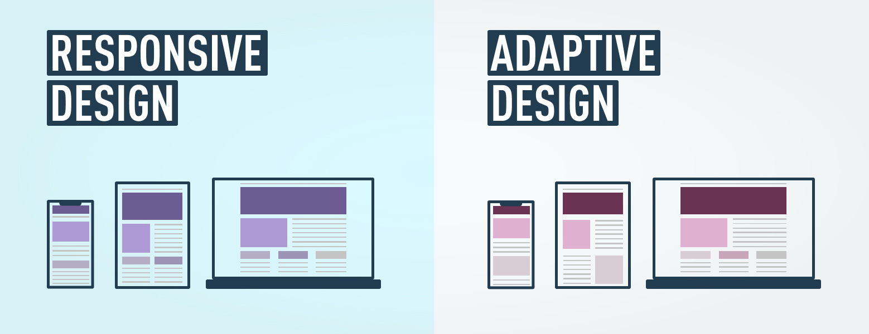
Visualization of Dashboards
Design Principles for Effective Dashboards
Responsiveness and Adaptability: Ensure the dashboard is responsive and adaptable to different screen sizes and devices, allowing users to access and view the dashboard on various platforms.
[Credit: https://www.datawiz.com/ ]
‹#›

Slide 11
Visualization of Dashboards
Examples of Dashboard Visualization
Line charts or area charts showing trends and fluctuations in key metrics over time.
Bar charts or column charts comparing performance or metrics across different categories or regions.
Gauges or progress indicators providing a visual representation of goal attainment or performance levels.
Heatmaps or choropleth maps showing geographical patterns or variations in data.
Tables or data grids presenting detailed tabular information for specific dimensions or metrics.
‹#›

Slide 12
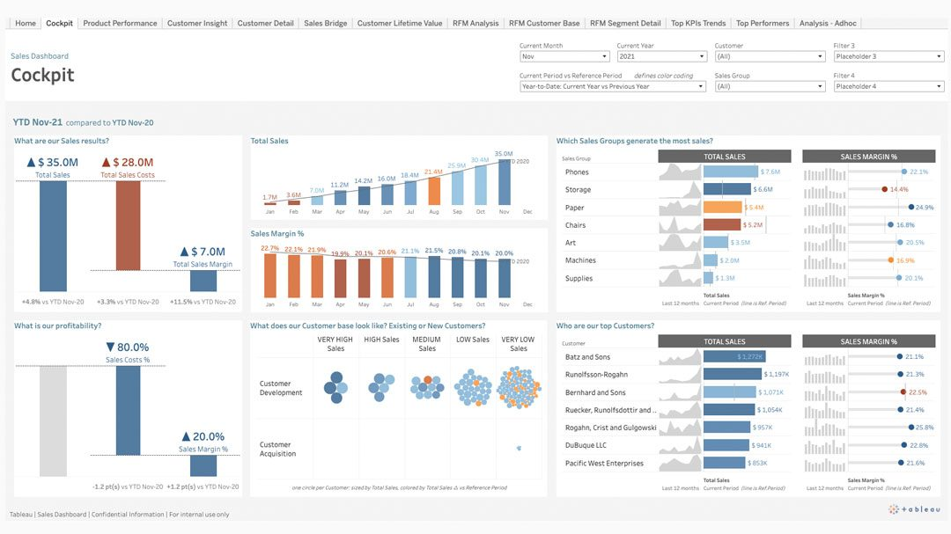
Visualization of Dashboards
Tools for Creating Interactive Dashboards
Tableau: A popular and powerful data visualization tool with extensive dashboard creation capabilities.
‹#›

Slide 13
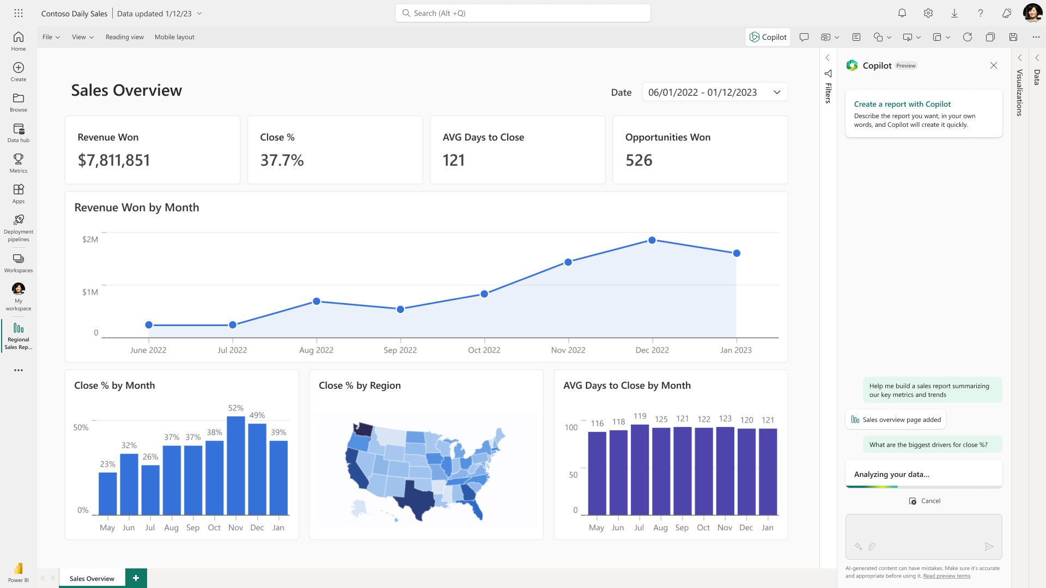
Visualization of Dashboards
Tools for Creating Interactive Dashboards
Power BI: Microsoft's business intelligence platform that enables the creation of interactive dashboards and reports.
‹#›

Slide 14
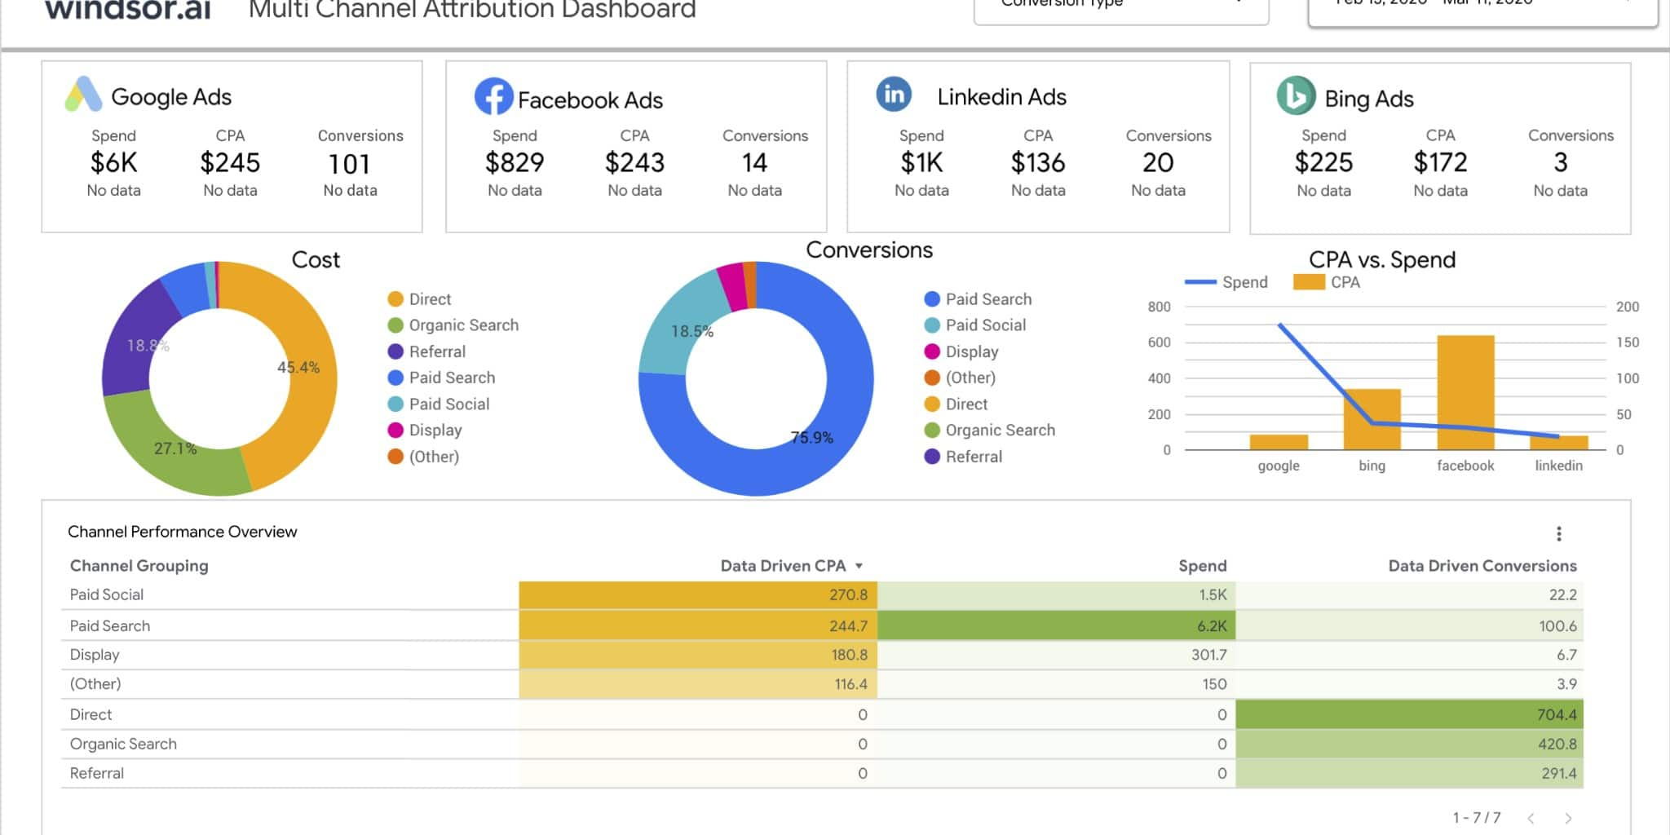
Visualization of Dashboards
Tools for Creating Interactive Dashboards
Google Data Studio: A free tool by Google for creating customizable dashboards and visualizations using various data sources.
‹#›

Slide 15
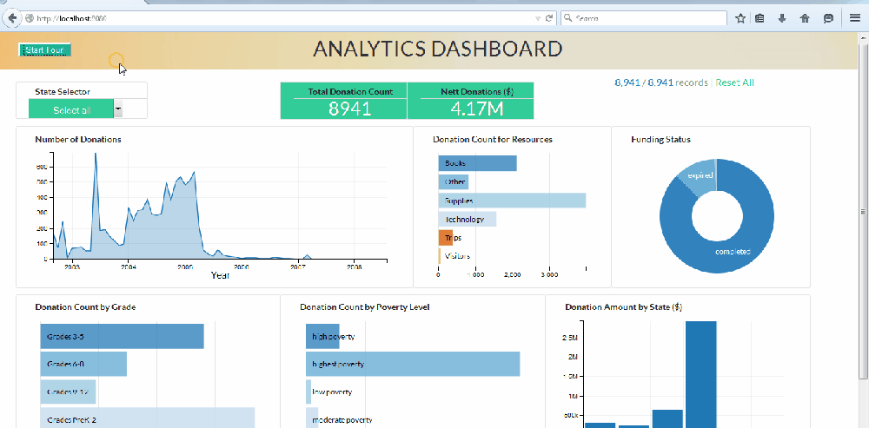
Visualization of Dashboards
Tools for Creating Interactive Dashboards
D3.js: A JavaScript library for creating custom, interactive, and dynamic visualizations and dashboards.
‹#›

Slide 16
Summary
Visualization of Dashboard
Dashboard Visualization:
- Learn about dashboard components.
- Explore design principles.
- Understand interactive features.
‹#›

